Slide 1
Salesforce Admin for Beginners
Chapter -01
Contents
Cloud Computing
Cloud Service Model
Salesforce & CRM Basics
Salesforce Environments

Slide 2
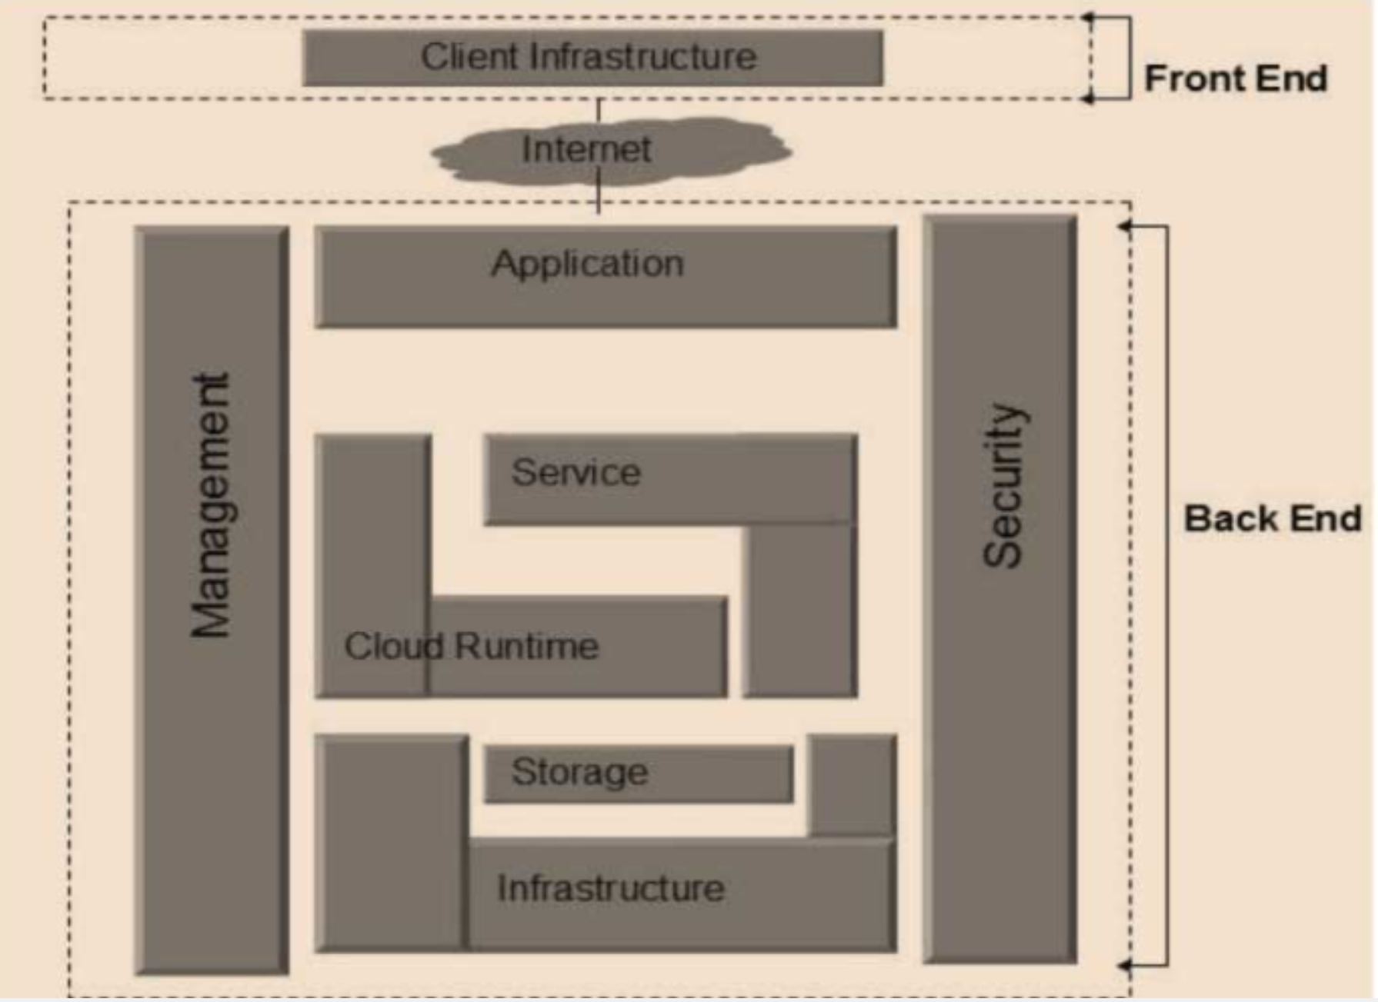
Cloud Computing
What is cloud Computing?
The term Cloud refers to a Network or the Internet. Cloud computing is nothing but internet computing. The cloud can provide services over networks i.e., on Public Networks or on Private Networks
i.e., WAN – Wide Area Network, LAN – Local Area Network. (high-processing computer) Applications such as Email, Web Conferencing, and Customer Relationship Management (CRM), all run in the cloud
What is Cloud Computing in Salesforce? It refers to the delivery of computing services—like servers, storage, databases, networking, software, analytics, and intelligence—over the cloud.
It offers platform independency, as the software is not required to be installed locally on the PC. Hence, it is making our business applications, mobile and collaborative.
Cloud Computing Architecture
We can broadly divide the cloud architecture into two parts:
Back End
Front End
Back End refers to the cloud itself. It consists of all the resources required to provide cloud computing services. It comprises huge Data Storage, Virtual Machines, Security mechanisms, Services, Deployment Models, Servers, etc.
Front End refers to the client part of the computing system. It consists of interfaces and applications that are required to access the computing platforms. Example: Web Browser

Slide 3
cloud service models?
Cloud Services
There are basically 3 types of cloud service models:
1. Infrastructure as a Service (IaaS)
2. Platform as a Service (PaaS)
3. Software as a Service (SaaS)
Provides access to fundamental resources such as Physical Machines, Virtual Machines, Storage, etc. All these resources are made available to the end user via server virtualization. Moreover, these resources are accessed by the customers as if they own them.
Examples: Servers & Storage
Provides the run time environment for applications. It also offers development & deployment tools, required to develop applications. PaaS has a feature of point-and-click tools that enables non-developers to create web applications
Examples: Web Servers, development tools etc.
This model allows software applications as a service to the end users. It refers to software that is deployed on a hosted service and is accessible via the internet. Examples: SaaS applications such as Billing & Invoicing Systems, Customer Relationship Management (CRM, Applications, Emails, Games
PaaS Characteristics:
● PaaS offers a browser-based development environment. It allows the developer to create a database and edit the application code either via Application Programming Interface or Point-and-Click tools.
● PaaS provides built-in security, scalability, and web service interfaces.
● PaaS also provides web services interfaces that allow us to connect the applications
outside the platform
Characteristics:
● Available on demand.
● Software is maintained by the vendor, hence making it cost-effective.
● Scaled up or down on demand.
● Automatically upgraded and updated.
● SaaS offers a Shared Data Model.
● All users are running the same version of the software.
IaaS Characteristics:
● Virtual machines with pre-installed software.
● Virtual machines with pre-installed operating systems such as Windows and Linux
● On-demand availability of resources.
● The computing resources can be easily scaled up and down.

Slide 4
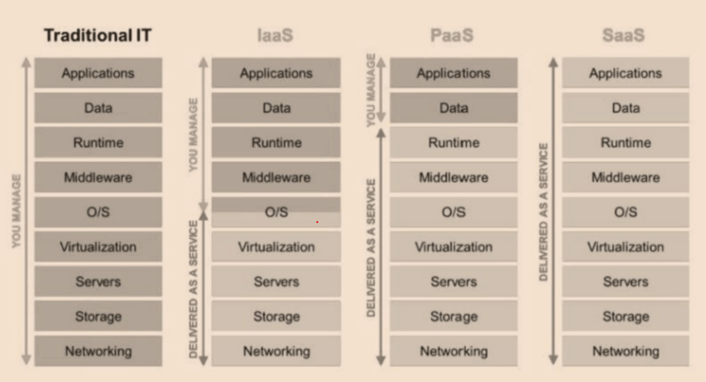
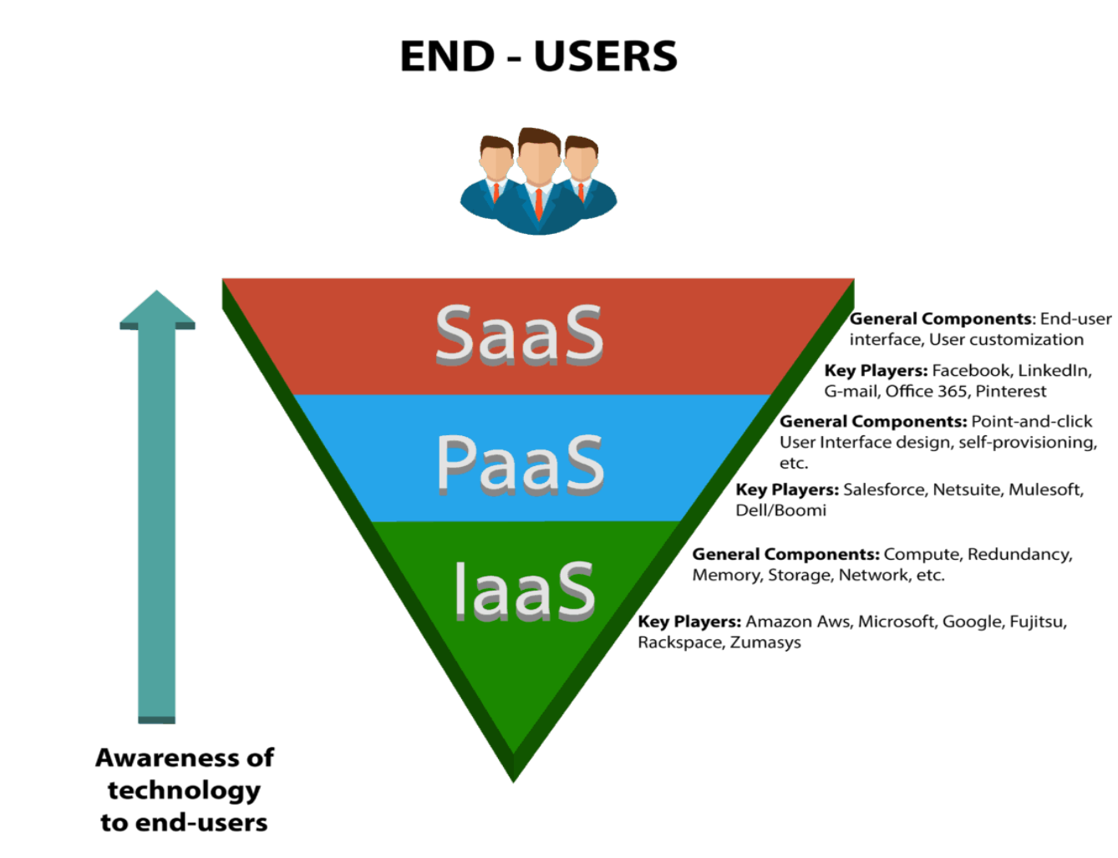

Slide 5
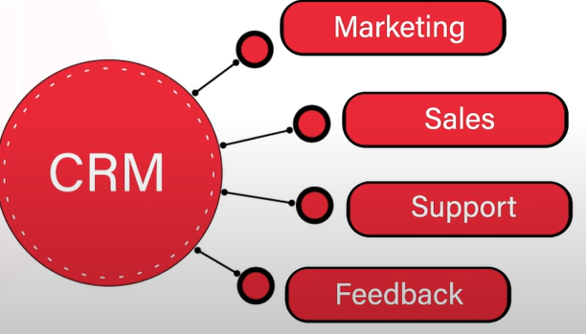
Salesforce and CRM Basics
Salesforce
Salesforce is a global web-based application and cloud computing company. It is best known for its Customer Relationship Management (CRM) product. They specialize in Software-as-a-Service (SaaS) to help users handle all of their business needs.
CRM
Other CRM Providers
CRM stands for Customer Relationship Management. It is a process or methodology used to learn more about customers’ needs and behaviors in order to develop stronger relationships with them.
Salesforce CRM
Microsoft Dynamics CRM
Oracle CRM
SAP CRM
Sage CRM
NetSuite CRM
Sugar CRM
Salesforce Editions:
Essential Edition
Professional Edition
Enterprise Edition
Unlimited Edition
Developer Edition
Salesforce CRM Services
Salesforce CRM service is broken down into several broad categories which are:
● Sales Cloud
● Service Cloud
● Data Cloud
● Marketing Cloud

Slide 6
Salesforce Environments
An environment is an instance of Force.com platform which can also be called an organization. Salesforce Environments lets users access, deploy or create applications with various feature sets, depending on the configuration of the environment.
Characteristics of an Environment:
● Contains data (records) and customizations.
● Each environment is based on an edition, which contains specific functionality and limits.
● Can be accessed through a web browser
Development Environments:
Salesforce Environments where users/developers can integrate and develop without affecting their production environments. Theses are used strictly for developing and testing apps. Theses environment contains test data and are not business critical.
Types of Salesforce Environments:
Production Environments:
Salesforce Environments that have active paying users accessing business-critical
data are known as Production Environments. It stores the live data that is actively used to run the business.
Production Environment
Development Environment
Testing Environment
Sandbox:
Sandbox is a nearly identical copy of the Production Environment. It can include data, configurations, or both.
Types of Sandbox:
Full Copy Sandbox
Partial Copy Sandbox
Developer Sandbox
Developer Pro Sandbox
Developer Edition (DE) Environment:
It is a free, fully-featured development environment with limits on data and users.
In Production Environment
Users or Developers can easily build
Custom Objects, field, validation rule, or custom application (with point & clicks only) but no Apex codes

Slide 7
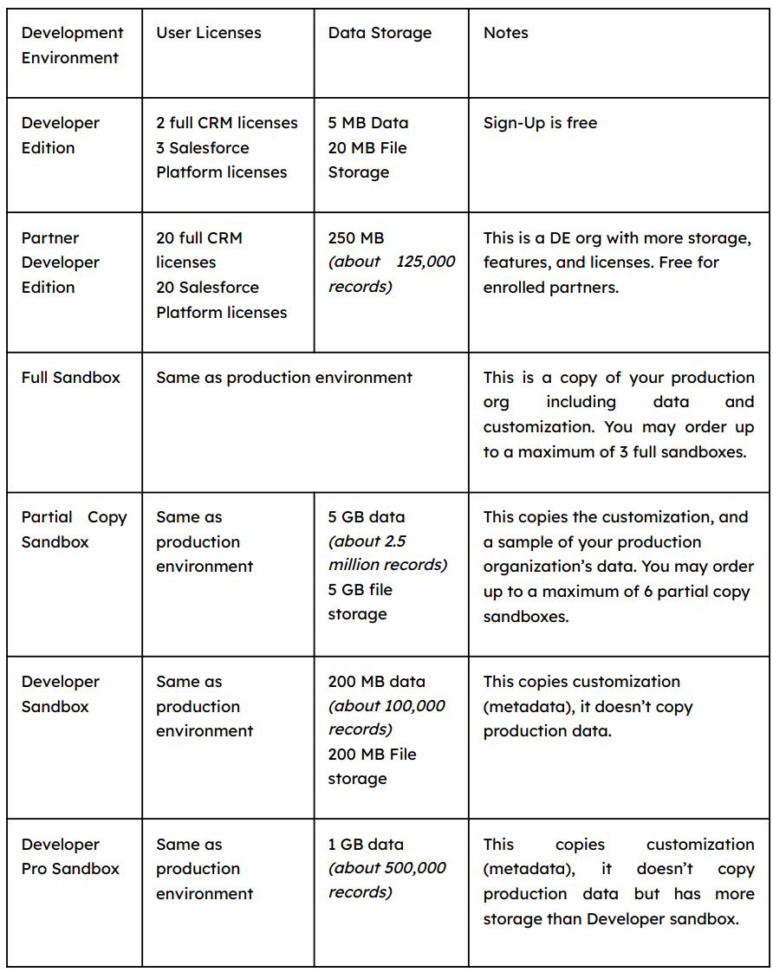
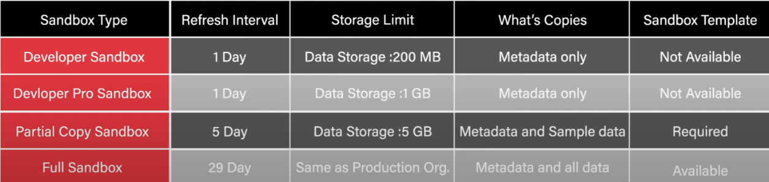
Testing Environments:
Dedicated Testing Environment where they users/developers can perform integration tests with large sets of data, do security checks for multiple users and profiles, and uncover bugs.
options for creating dedicated Testing Environments:
Create a Sandbox copy of Production Environment.
Use DE as testing environment.
Partner Developer edition

Slide 8
